Slide 1
Data Encryption Standard DES

Slide 2
Block cipher
Block cipher processes are classified into five categories:
CFB (Cipher Feedback),
OFB (Output Feedback),
CTR (Counter),
CBC (Cipher Block Chaining), and
ECB (Electronic Code Block).

Slide 3
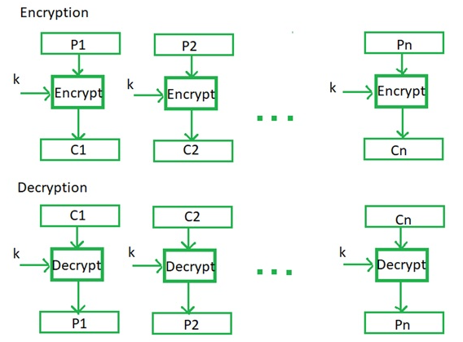
Electronic Code Book

Slide 4
Electronic Code Book
Pros
Simplest mode
Ideal for short amount of data. Ex: secure transfer of AES /DES key
Independent= Can encrypt any block
Fast –Parallelism
Cons
Not secure for lengthy messages
Cryptanalyst can exploit the regularities of the message

Slide 5
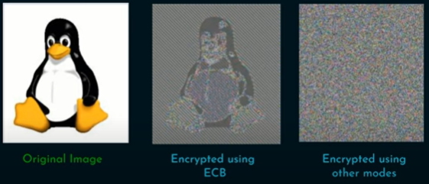
Electronic Code Book
Regularities of the message

Slide 6
Cipher Block Chaining Mode
The input to the encryption algorithm is the XOR of the next 64 bits of plaintext and the preceding 64 bits of ciphertext.

Slide 7
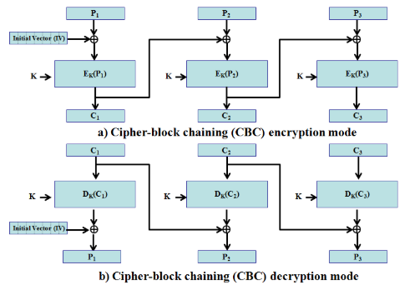
Cipher Block Chaining Mode

Slide 8
Cipher Block Chaining Mode
Pros
High Security:
CBC effectively hides patterns in the plaintext by XORing each plaintext block with the previous ciphertext block, making it significantly more resistant to cryptanalysis compared to ECB.
Widely Used:
Due to its security and ease of implementation, CBC is one of the most commonly used block cipher modes in various applications.
Flexibility:
CBC can be used to encrypt data streams of any length by utilizing an initialization vector (IV) to start the chaining process.

Slide 9
Cipher Block Chaining Mode
Cons
Error Propagation:
A major concern with CBC is that if an error occurs during encryption (e.g., bit flip) in one block, it will affect the decryption of all subsequent blocks due to the chaining mechanism.
Sequential Encryption/Decryption:
Unlike some other modes, CBC requires blocks to be encrypted and decrypted sequentially, which can potentially impact performance in certain scenarios.
IV Management:
Proper management of the initialization vector (IV) is crucial for security; reusing IVs with the same key can compromise the encryption.

Slide 10
DES
The Data Encryption Standard is a symmetric-key algorithm for the encryption of digital data.
Developed in the early 1970’s by IBM and was published as an Official Federal Information Processing Standard in 1976.
Adopted by NIST in 1977
Input:64 bits
Output:64 bits
Main Key;64 bits
SubKey:56 bits
Round key: 48 bits(generated from Subkey)
No.of rounds:16 rounds
Notes:
Take group of byte as an input
DES is replaced by AES because of vulnerabilities

Slide 11
Overview of DES – Block Diagram

Slide 12
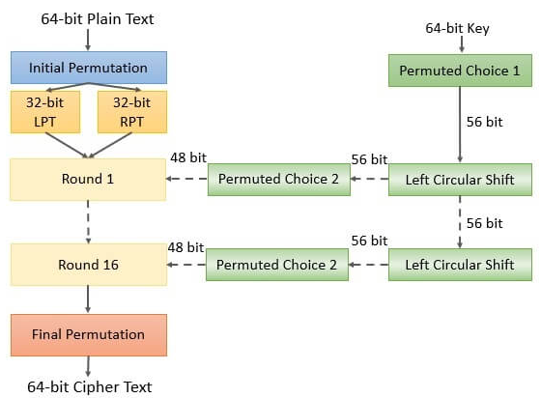
Data Encryption Standard

Slide 13
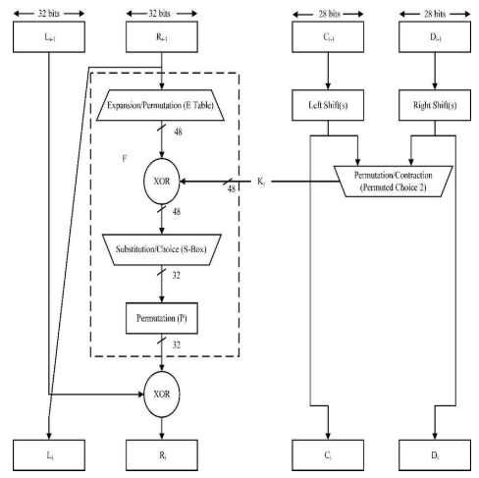

Data Encryption Standard
Single Round of DES Algorithm
Notes:
56 bits input
Permuted choice input is 48 bits

Slide 14
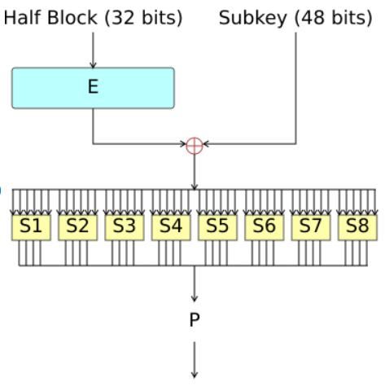
Data Encryption Standard
Fiestal Function

Slide 16
Generating 16 Sub Keys
Key in Hexadecimal = 133457799BBCDFF1
K = 00010011 00110100 01010111 01111001 10011011 10111100 11011111 11110001

Slide 17
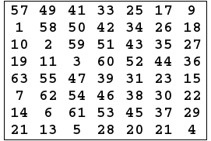
Generating 16 Sub Keys
The 64-bit key is permuted according to the following table, PC-1.
Note only 56 bits of the original key appear in the permuted key.
K = 00010011 00110100 01010111 01111001 10011011 10111100 11011111 11110001
we get the 56-bit permutation
K+ = 1111000 0110011 0010101 0101111 0101010 1011001 1001111 0001111
PC-1

Slide 18
Generating 16 Sub Keys
we get the 56-bit permutation
K+ = 1111000 0110011 0010101 0101111 0101010 1011001 1001111 0001111
Next, split this key into left and right halves, C0 and D0, where each half has 28 bits.
From the permuted key K+, we get
C0 = 1111000 0110011 0010101 0101111
D0 = 0101010 1011001 1001111 0001111

Slide 19
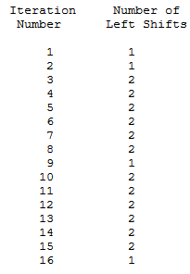
Generating 16 Sub Keys
From the previous slide
C0 = 1111000011001100101010101111
D0 = 0101010101100110011110001111
C₁ = 1110000110011001010101011111 D₁ = 1010101011001100111100011110
C₂ = 1100001100110010101010111111 D₂ = 0101010110011001111000111101
C₃ = 0000110011001010101011111111 D₃ = 0101011001100111100011110101
C₄ = 0011001100101010101111111100 D₄ = 0101100110011110001111010101
C₅ = 1100110010101010111111110000 D₅ = 0110011001111000111101010101
schedule of "left shifts"

Slide 20
Generating 16 Sub Keys
C₆ = 0011001010101011111111000011 D₆ = 1001100111100011110101010101
C₇ = 1100101010101111111100001100 D₇ = 0110011110001111010101010110
C₈ = 0010101010111111110000110011 D₈ = 1001111000111101010101011001
C₉ = 0101010101111111100001100110 D₉ = 0011110001111010101010110011
C₁₀ = 0101010111111110000110011001 D₁₀ = 1111000111101010101011001100
C₁₁ = 0101011111111000011001100101 D₁₁ = 1100011110101010101100110011
C₁₂ = 0101111111100001100110010101 D₁₂ = 0001111010101010110011001111
C₁₃ = 0111111110000110011001010101 D₁₃ = 0111101010101011001100111100
C₁₄ = 1111111000011001100101010101 D₁₄ = 1110101010101100110011110001
C₁₅ = 1111100001100110010101010111 D₁₅ = 1010101010110011001111000111
C₁₆ = 1111000011001100101010101111 D₁₆ = 0101010101100110011110001111

Slide 21
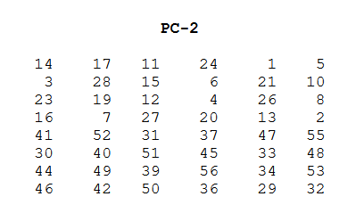
Generating 16 Sub Keys
We now form the keys K_{n}, for 1<=n<=16, by applying the following permutation table to each of the concatenated pairs C_{n}D_{n}.
Each pair has 56 bits, but PC-2 only uses 48 of these.
C₁ = 1110000110011001010101011111 D₁ = 1010101011001100111100011110
C₁D₁ = 1110000 1100110 0101010 1011111 1010101 0110011 0011110 0011110
K₁ = 000110 110000 001011 101111 111111 000111 000001 110010

Slide 22
Generating 16 Sub Keys
C₂ = 1100001100110010101010111111 D₂ = 0101010110011001111000111101
C₂D₂ 1100001 1001100 1010101 0111111 0101010 1100110 0111100 0111101
K₂ = 011110 011010111011011001110110111100100111100101

Slide 23
Generating 16 Sub Keys
K₁ = 000110 110000 001011 101111 111111 000111 000001 110010
K₂ = 011110 011010 111011 011001 110110 111100 100111 100101 K₃ = 010101 011111 110010 001010 010000 101100 111110 011001 K₄ = 011100 101010 110111 010110 110110 110011 010100 011101 K₅ = 011111 001110 110000 000111 111010 110101 001110 101000 K₆ = 011000 111010 010100 111110 010100 000111 101100 101111 K₇ = 111011 001000 010010 110111 111101 100001 100010 111100 K₈ = 111101 111000 101000 111010 110000 010011 101111 111011 K₉ = 111000 001101 101111 101011 111011 011110 011110 000001 K₁₀ = 101100 011111 001101 000111 101110 100100 011001 001111 K₁₁ = 001000 010101 111111 010011 110111 101101 001110 000110 K₁₂ = 011101 010111 000111 110101 100101 000110 011111 101001 K₁₃ = 100101 111100 010111 010001 111110 101011 101001 000001 K₁₄ = 010111 110100 001110 110111 111100 101110 011100 111010 K₁₅ = 101111 111001 000110 001101 001111 010011 111100 001010 K₁₆ = 110010 110011 110110 001011 000011 100001 011111 110101

Slide 25
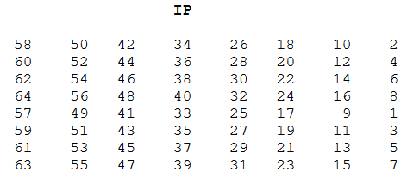
Step 2: Encode each 64-bit block of data.
M = 0000 0001 0010 0011 0100 0101 0110 0111 1000 1001 1010 1011 1100 1101 1110 1111
There is an initial permutation IP of the 64 bits of the message data M
IP = 1100 1100 0000 0000 1100 1100 1111 1111 1111 0000 1010 1010 1111 0000 1010 1010

Slide 26
Step 2: Encode each 64-bit block of data
IP = 1100 1100 0000 0000 1100 1100 1111 1111 1111 0000 1010 1010 1111 0000 1010 1010
Next divide the permuted block IP into a
left half L₀ of 32 bits,
and a right half R₀ of 32 bits.
L₀ = 1100 1100 0000 0000 1100 1100 1111 1111 R₀ = 1111 0000 1010 1010 1111 0000 1010 1010

Slide 28
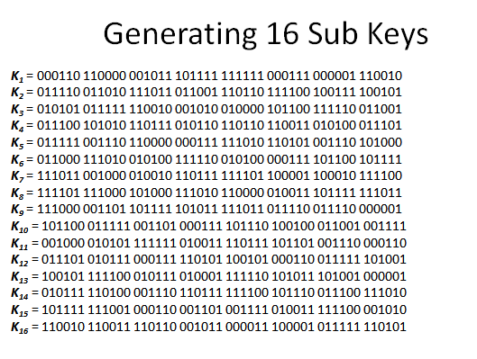
16 Rounds - Take a look at first round
L₀ = 1100 1100 0000 0000 1100 1100 1111 1111 R₀ = 1111 0000 1010 1010 1111 0000 1010 1010
L_{n} = R_{n-1} R_{n} = L_{n-1} + f(R_{n-1},K_{n})
Let + denote XOR addition
n=1 for round 1
L₁ = R₁₋₁ R₁ = L₁₋₁ + f(R₁₋₁,K₁)
L₁ = R₀ R₁ = L₀ + f(R₀,K₁)
For n = 1, we have
K₁ = 000110 110000 001011 101111 111111 000111 000001 110010 L₁ = R₀ = 1111 0000 1010 1010 1111 0000 1010 1010 R₁ = L₀ + f(R₀,K₁)

Slide 29
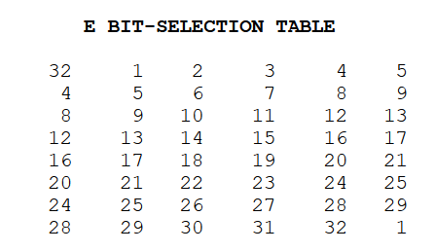
What is f(R₀,K₁) ?
R₀ = 1111 0000 1010 1010 1111 0000 1010 1010
To calculate f, we first expand each block R₀ from 32 bits to 48 bits.
This is done by using a selection table that repeats some of the bits in R₀ .
We'll call the use of this selection table the function E.
Thus E(R₀) has a 32 bit input block, and a 48 bit output block.
E(R₀) = 011110 100001 010101 010101 011110 100001 010101 010101

Slide 30
Data Encryption Standard
Fiestal Function

Slide 31
f(R₀,K₁)
E(R₀) = 011110 100001 010101 010101 011110 100001 010101 010101
Next in the f calculation, we XOR the output E(R₀) with the key K₁:
K₁ + E(R₀).
K₁ = 000110 110000 001011 101111 111111 000111 000001 110010 E(R₀) = 011110 100001 010101 010101 011110 100001 010101 010101 K₁+E(R₀) = 011000 010001 011110 111010 100001 100110 010100 100111.
The result is 48 bits or we can say eight group containing six bits

Slide 32
f(R₀,K₁)
We now do something strange with each group of six bits: we use them as addresses in tables called "S boxes".
K₁+E(R₀) = 011000 010001 011110 111010 100001 100110 010100 100111.
K1+ E(R0) = B1 B2 B3 B4 B5 B6 B7 B8
We now calculate
S₁(B₁) S₂(B₂) S₃(B₃) S₄(B₄) S₅(B₅) S₆(B₆) S₇(B₇) S₈(B₈)

Slide 33
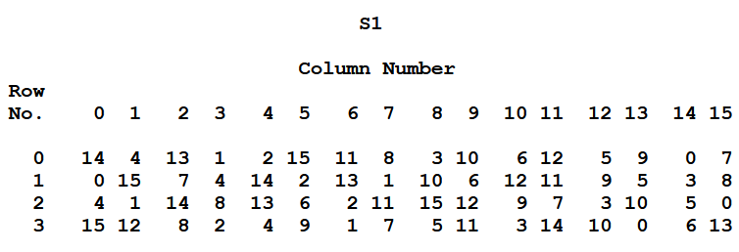
f(R₀,K₁) - S₁(B₁)
K₁+E(R₀) = 011000 010001 011110 111010 100001 100110 010100 100111.
K1+ E(R0) = B1 B2 B3 B4 B5 B6 B7 B8
We now calculate
S₁(B₁) S₂(B₂) S₃(B₃) S₄(B₄) S₅(B₅) S₆(B₆) S₇(B₇) S₈(B₈)
B₁
011000
S₁(B₁)
0101

Slide 34
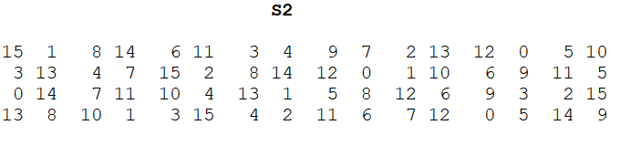
f(R₀,K₁) – S₂(B₂)
K₁+E(R₀) = 011000 010001 011110 111010 100001 100110 010100 100111.
K1+ E(R0) = B1 B2 B3 B4 B5 B6 B7 B8
We now calculate
S₁(B₁) S₂(B₂) S₃(B₃) S₄(B₄) S₅(B₅) S₆(B₆) S₇(B₇) S₈(B₈)
B₂
010001
S₂(B₂)
1100

Slide 35
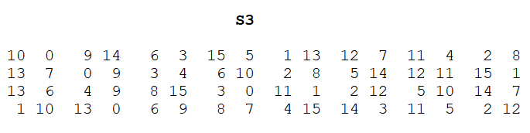
f(R₀,K₁) – S₃(B₃)
K₁+E(R₀) = 011000 010001 011110 111010 100001 100110 010100 100111.
K1+ E(R0) = B1 B2 B3 B4 B5 B6 B7 B8
We now calculate
S₁(B₁) S₂(B₂) S₃(B₃) S₄(B₄) S₅(B₅) S₆(B₆) S₇(B₇) S₈(B₈)
B₃
011110
S₃(B₃)
1000

Slide 36
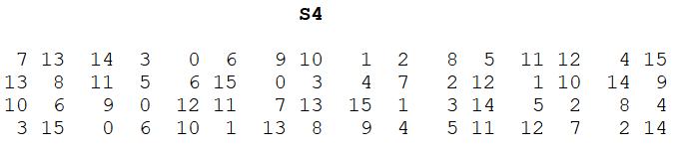
f(R₀,K₁) – S₄(B₄)
K₁+E(R₀) = 011000 010001 011110 111010 100001 100110 010100 100111.
K1+ E(R0) = B1 B2 B3 B4 B5 B6 B7 B8
We now calculate
S₁(B₁) S₂(B₂) S₃(B₃) S₄(B₄) S₅(B₅) S₆(B₆) S₇(B₇) S₈(B₈)
S₄(B₄)
111010
S₄(B₄)
0010

Slide 37
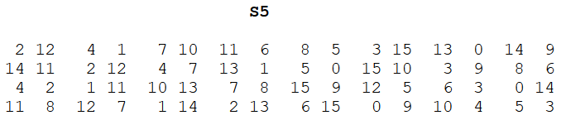
f(R₀,K₁) – S₅(B₅)
K₁+E(R₀) = 011000 010001 011110 111010 100001 100110 010100 100111.
K1+ E(R0) = B1 B2 B3 B4 B5 B6 B7 B8
We now calculate
S₁(B₁) S₂(B₂) S₃(B₃) S₄(B₄) S₅(B₅) S₆(B₆) S₇(B₇) S₈(B₈)
S₅(B₅)
100001
S₅(B₅)
1011

Slide 38
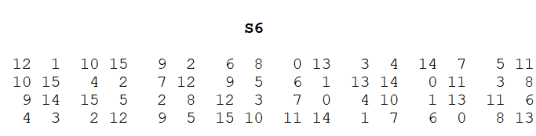
f(R₀,K₁) – S₆(B₆)
K₁+E(R₀) = 011000 010001 011110 111010 100001 100110 010100 100111.
K1+ E(R0) = B1 B2 B3 B4 B5 B6 B7 B8
We now calculate
S₁(B₁) S₂(B₂) S₃(B₃) S₄(B₄) S₅(B₅) S₆(B₆) S₇(B₇) S₈(B₈)
S₆(B₆)
100110
S₆(B₆)
0101

Slide 39
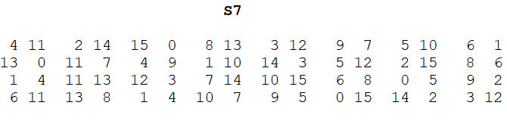
f(R₀,K₁) – S₇(B₇)
K₁+E(R₀) = 011000 010001 011110 111010 100001 100110 010100 100111.
K1+ E(R0) = B1 B2 B3 B4 B5 B6 B7 B8
We now calculate
S₁(B₁) S₂(B₂) S₃(B₃) S₄(B₄) S₅(B₅) S₆(B₆) S₇(B₇) S₈(B₈)
S₇(B₇)
010100
S₇(B₇)
1001

Slide 40
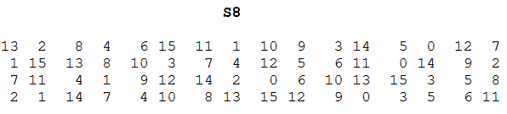
f(R₀,K₁) – S₈(B₈)
K₁+E(R₀) = 011000 010001 011110 111010 100001 100110 010100 100111.
K1+ E(R0) = B1 B2 B3 B4 B5 B6 B7 B8
We now calculate
S₁(B₁) S₂(B₂) S₃(B₃) S₄(B₄) S₅(B₅) S₆(B₆) S₇(B₇) S₈(B₈)
S₈(B₈)
100111
S₈(B₈)
0111

Slide 41
f(R₀,K₁)
K₁+E(R₀) = 011000 010001 011110 111010 100001 100110 010100 100111.
K1+ E(R0) = B1 B2 B3 B4 B5 B6 B7 B8
We now calculate
S₁(B₁) S₂(B₂) S₃(B₃) S₄(B₄) S₅(B₅) S₆(B₆) S₇(B₇) S₈(B₈)
S₁(B₁)S₂(B₂)S₃(B₃)S₄(B₄)S₅(B₅)S₆(B₆)S₇(B₇)S₈(B₈)
= 0101 1100 1000 0010 1011 0101 1001 0111

Slide 42
Data Encryption Standard
Fiestal Function

Slide 43
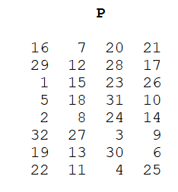
f(R₀,K₁) - Final stage of f- Permutation
S₁(B₁)S₂(B₂)S₃(B₃)S₄(B₄)S₅(B₅)S₆(B₆)S₇(B₇)S₈(B₈)
= 0101 1100 1000 0010 1011 0101 1001 0111
we get
f(R₀,K₁) = 0010 0011 0100 1010 1010 1001 1011 1011

Slide 44
Remember why we computed f(R₀,K₁)
L₀ = 1100 1100 0000 0000 1100 1100 1111 1111 R₀ = 1111 0000 1010 1010 1111 0000 1010 1010
L_{n} = R_{n-1} R_{n} = L_{n-1} + f(R_{n-1},K_{n})
Let + denote XOR addition
n=1 for round 1
L₁ = R₁₋₁ R₁ = L₁₋₁ + f(R₁₋₁,K₁)
L₁ = R₀ R₁ = L₀ + f(R₀,K₁)
For n = 1, we have
K₁ = 000110 110000 001011 101111 111111 000111 000001 110010 L₁ = R₀ = 1111 0000 1010 1010 1111 0000 1010 1010 R₁ = L₀ + f(R₀,K₁)

Slide 45
Finding output of Round 1
f(R₀,K₁) = 0010 0011 0100 1010 1010 1001 1011 1011
L0 = 1100 1100 0000 0000 1100 1100 1111 1111 R0 = 1111 0000 1010 1010 1111 0000 1010 1010
For n = 1, we have
L₁ = R₀ = 1111 0000 1010 1010 1111 0000 1010 1010 R₁ = L₀ ⊕ f(R₀,K₁)
= 1100 1100 0000 0000 1100 1100 1111 1111 ⊕ 0010 0011 0100 1010 1010 1001 1011 1011
R1 = 1110 1111 0100 1010 0110 0101 0100 0100
L1 = 1111 0000 1010 1010 1111 0000 1010 1010

Slide 47
Let us start Round 2
L₁ = 1111 0000 1010 1010 1111 0000 1010 1010 R₁ = 1110 1111 0100 1010 0110 0101 0100 0100
L_{n} = R_{n-1} R_{n} = L_{n-1} + f(R_{n-1},K_{n})
Let + denote XOR addition
n=2 for round 2
L₂ = R₂₋₁ R₂ = L₂₋₁ + f(R2₋₁,K₂)
L₂ = R₁ R₂ = L₁ + f(R₁,K₂)
For n = 1, we have
K₂ = 011110 011010 111011 011001 110110 111100 100111 100101 L₂ = R₁ = 1111 0000 1010 1010 1111 0000 1010 1010 R₂ = L₁ ⊕ f(R₁,K₂)

Slide 48
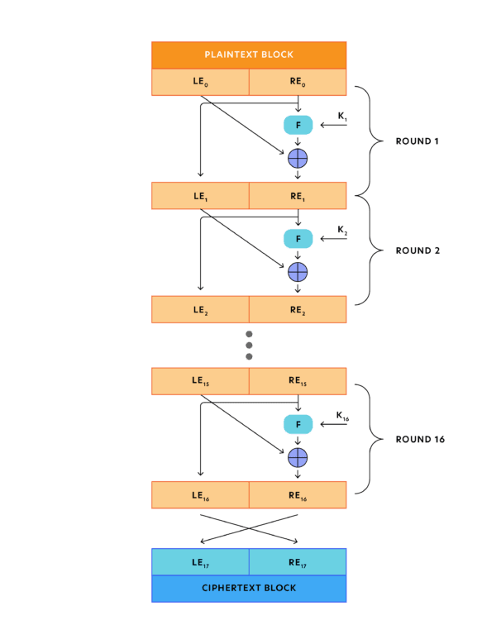

Slide 50
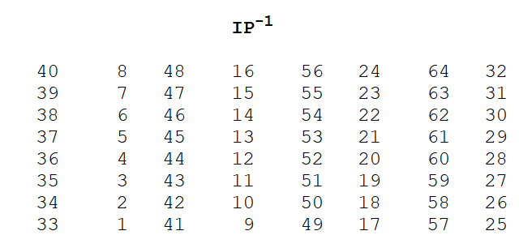
Finally after 16 Rounds
Output of 16 Rounds
L₁₆ = 0100 0011 0100 0010 0011 0010 0011 0100 R₁₆ = 0000 1010 0100 1100 1101 1001 1001 0101
We reverse the order of these two blocks and apply the final permutation to
R₁₆L₁₆ = 00001010 01001100 11011001 10010101 01000011 01000010 00110010 00110100
IP⁻¹ = 10000101 11101000 00010011 01010100 00001111 00001010 10110100 00000101
Cyphertext which in hexadecimal format is
85E813540F0AB405.

Slide 51
The Truth
DES is insecure due to the relatively short 56-bit key size.
In January 1999, distributed.net and the Electronic Frontier Foundation collaborated to publicly break a DES key in 22 hours and 15 minutes
This cipher has been superseded by the Advanced Encryption Standard (AES).
DES has been withdrawn as a standard by the National Institute of Standards and Technology.

